Slide 1
Lectures for statistical genetics in PNU-winter-workshop-2019
Kipoong Kim, Hansong Lee
January 2019

Slide 2
Part 1. GAPIT

Slide 3
Contents
1. Introduction to Genome-wide Association Studies (GWAS)
2. Statistical Model of GAPIT
3. Quality Control(QC) before Analysis
4. Analysis using GAPIT & result
code 1: treating heterozygosity
code 2: imputation and controlling MAF
code 3: optimal PC number
code 4 : Compressed MLM
code 5 : Enriched CMLM

Slide 4
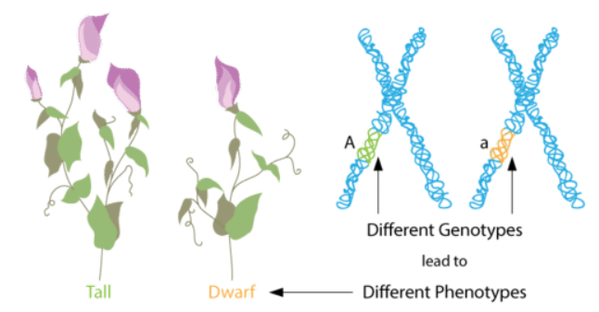
1. Introduction to Genome-wide Association Studies (GWAS)
Observational study of a genome-wide set of genetic variants in different individuals to see if any variant is associated with a trait.
Compare the DNA(ex.SNP) of samples having varying phenotypes for a particular trait or disease.
If one type of the variant (one allele) is more frequent in sample, the variant is said to be associated with the disease. The associated SNPs are then considered to mark a region of the human genome that may influence the risk of disease.

Slide 5
Association Study
1) Population based association study
A common design for association studies is population-based, where unrelated subjects are collected.
when samples are of different ethnic ancestries, population-based association studies may produce spurious associations due to population stratification.
2) Family based association study
An alternative design uses family-based studies, where family members are collected for association analyses.
This methods protect against population stratification, but costly.

Slide 6
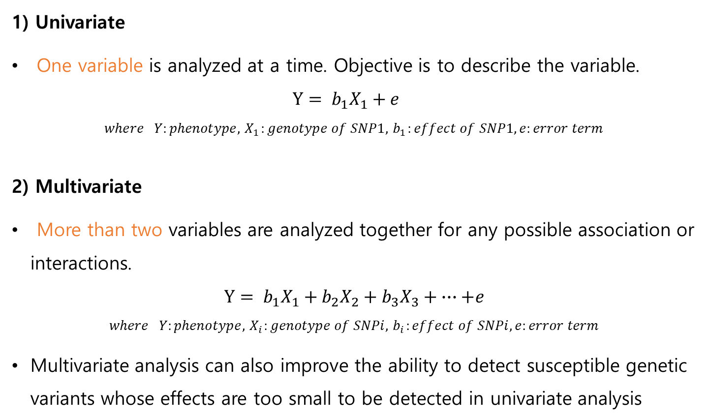
Univaraite Analysis vs Multivariate Analysis
1) Univariate
One variable is analyzed at a time. Objective is to describe the variable.
$$Y= b_{1}X_{1}+e$$
$$where Y:phenotype, { X}_{1}:genotype of SNP1,{ b}_{1}:effect of SNP1, e:error term$$
2) Multivariate
More than two variables are analyzed together for any possible association or interactions.
$$Y= b_{1}X_{1}+b_{2}X_{2}+b_{3}X_{3}+ ∙∙∙+e$$
$$where Y:phenotype, { X}_{i}:genotype of SNPi,{ b}_{i}:effect of SNPi,e:error term$$
Multivariate analysis can also improve the ability to detect susceptible genetic variants whose effects are too small to be detected in univariate analysis

Slide 7
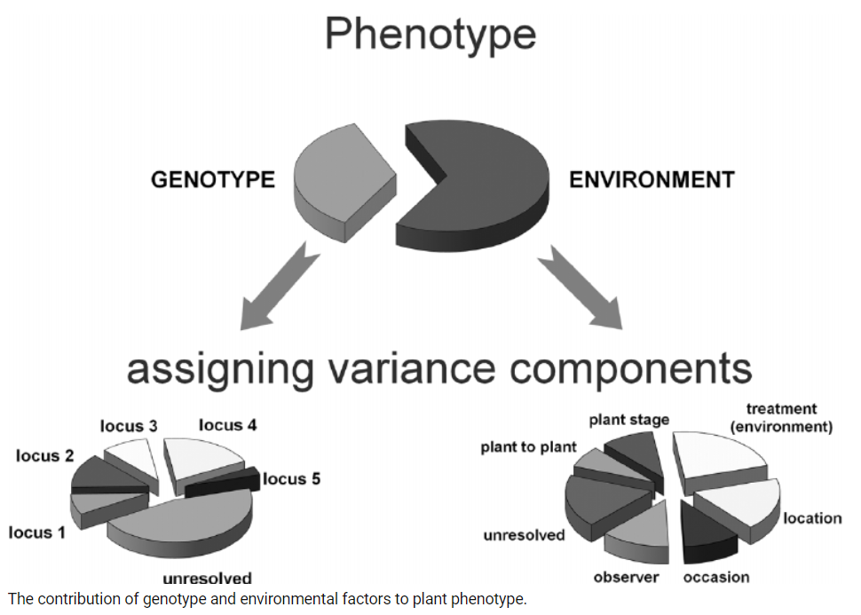
GWAS with covariate
As in main-effects GWAS that search for the effects of genotype alone, differences(termed population substructure) can be mistaken for true genetic effects, and is therefore a serious concern.
The extent of the substructure problem can be inspected by using
Inflation factor λ: Inflation factor λ > 1 indicates population structure and/or genotyping error
QQ plot
1 Hunter DJ (2005) Gene-environment interactions in human diseases. Nat Rev Genet 6: 287–298
2 Behavior of QQ-Plots and Genomic Control in Studies of Gene-Environment Interaction

Slide 8
2. Statistical Models of GAPIT
• Concept of fixed & random effect
fixed effect
A fixed effect is a factor whose level is selected by a procedure that is not random, or is made up of possible levels in the entire population.
Researchers are interested in comparing the effects of factors only for the levels of response variables included in the study.
“FIXED EFFECT MODEL”
random effect
Factor levels are often various and researchers or data analysts choose subset levels to include in the study.
This effect is called “random effect”.
“RANDOM EFFECT MODEL”

Slide 9
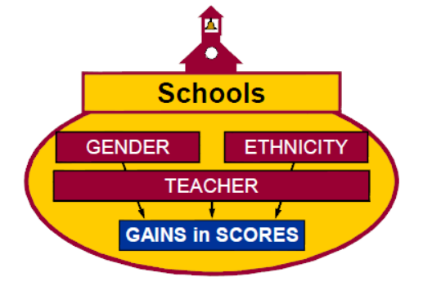
Concept of fixed & random effect
ex) In all schools in a school district, test scores, gender and ethnicities of 4-th grade students, and teacher identification were recorded. The main purpose of this data set was
to assess the school with a test score
to assess gender and ethnicity.
Schools, Gender, Ethnicity : fixed effect
Teacher : random effect

Slide 10
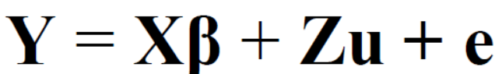
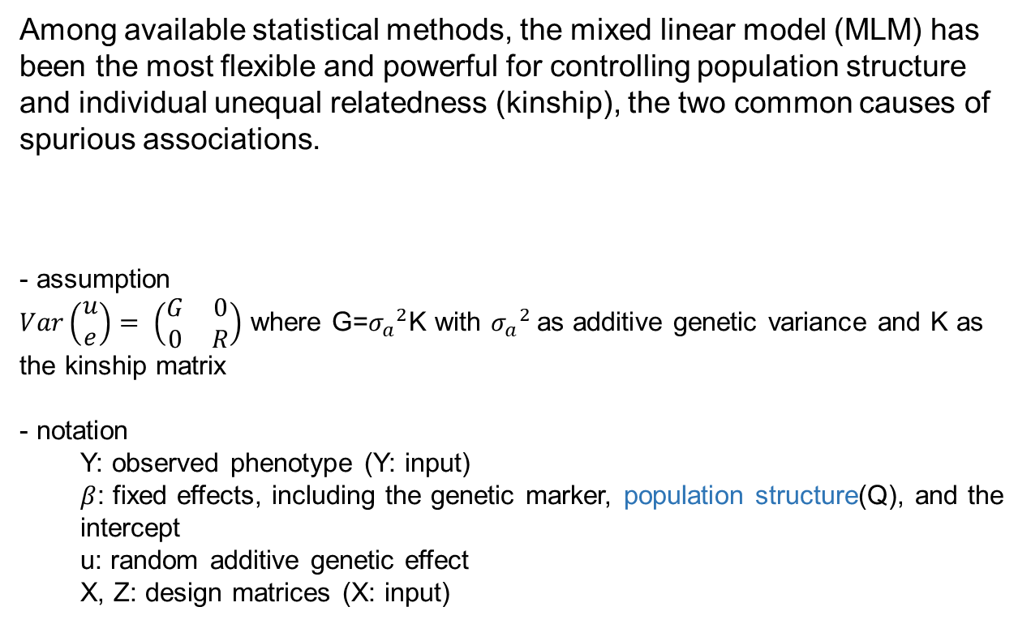
MLM(mixed linear model)
Among available statistical methods, the mixed linear model (MLM) has been the most flexible and powerful for controlling population structure and individual unequal relatedness (kinship), the two common causes of spurious associations.
- assumption
$Var\left(\begin{aligned}u \\ e\end{aligned}\right)= \left(\begin{matrix}G & 0 \\ 0 & R\end{matrix}\right)$ where G=${σ_{a}}^{2}$K with ${σ_{a}}^{2}$as additive genetic variance and K as the kinship matrix
- notation
Y: observed phenotype (Y: input)
$β$: fixed effects, including the genetic marker, population structure(Q), and the intercept
u: random additive genetic effect
X, Z: design matrices (X: input)

Slide 11
Population stratification (or population structure)
the presence of a systematic difference in allele frequencies between subpopulations in a population, possibly due to different ancestry, especially in the context of association studies.
population stratification can result in excess false positive or false negative.
QQ plot, genetic inflation factor, PCoA plot can be used.

Slide 12
Models in GAPIT
• CMLM(compressed MLM)
Regular MLM is an extreme case of CMLM where each individual is considered as a group.
CMLM methods reduces the size of the random genetic effect in the absence of pedigree information and eliminate iterations.
• ECMLM(enriched CMLM)
The ECMLM calculates kinship using several different algorithms and then chooses the best combination between kinship algorithms and grouping algorithms.
The model fit was reflected by twice negative log likelihood (−2LL).

Slide 13
3. Quality Control(QC) before Analysis
• call rate
Markers with low call rate(poor quality DNA sample) should be eliminated.
Classically, markers with a call rate less than 95% are removed from further study.
• Hardy-Weinberg equilibrium, HWE
Departure from this equilibrium can be indicative of potential genotyping errors, population stratification, or even actual association to the trait under study.

Slide 14
Quality Control(QC) before Analysis
• Minor allele frequency, MAF
It is important to filter SNPs base on MAF, because statistical power is extremely low for rare SNPs. However, many causal genetic variants are rare. A recommended practice is to not remove them, but interpret them
with caution.
marker quality
marker genotyping call rate
Hardy-Weignberg equilibrium
minor allele frequency
remove poor-quality SNPs

Slide 15
4. Analysis using GAPIT
INPUT
• Genotypic Data: HapMap format or in numeric format
HapMap
- SNP information in row and taxa information in first 11 columns.
GAPIT uses only 3 of these: (8 columns can be “NA”s)
“rs” column: the SNP name;
“chrom” column: which is the SNP’s chromosome;
“pos” column: SNP’s base pair (bp) position
- Missing genotypic data are indicated by either “NN” (double bit) or “N” (single bit).
- The first row contains the header labels (head=F).

Slide 16
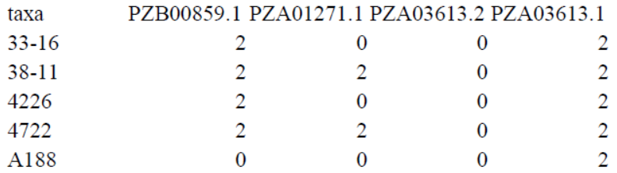
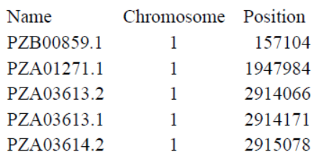
INPUT
2) Numeric
Columns are used for SNPs and rows are used for taxa.
Two separate files must be provided to GAPIT.
One(called “GD” file): numeric genotypic data
the other(called “GM” file): contains the position of each SNP along the genome with same order of “GD” file’s SNPs.
<GD file> <GM file>

Slide 17
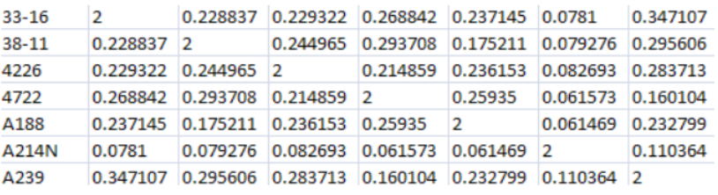
INPUT
• Phenotypic Data
Taxa names should be in the first column.
The remaining columns should contain the observed phenotype from each individual.
Missing phenotypic data should be indicated by either “NaN” or “NA”.
• Kinship
n by n+1 matrix
It is an option to put Kinship matrix, because GAPIT calculate kinship matrix automatically.

Slide 18
kinship matrix
Using kinship information, GAPIT makes group and
Depending on the options you specify, the objects that belong to each group are different.
kinship.algorithm
VanRaden(default) : more similar minor allele, higher kinship value
Separation : make kinship matrix using princal component of var-covariance
Zhang : farther form average allele, higher kinship value
EMMA : make kinship matrix using heterozygosity

Slide 19
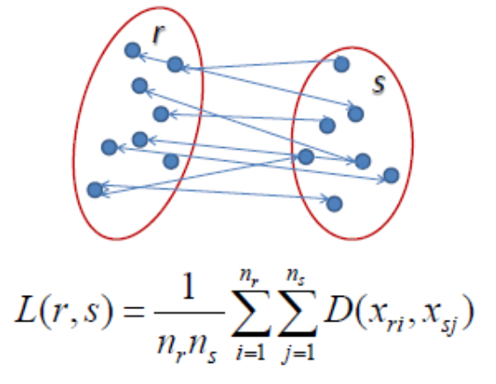
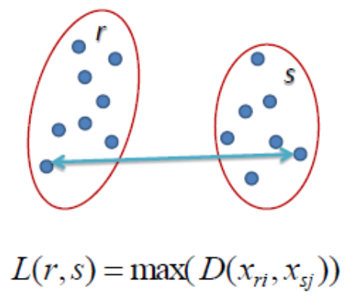
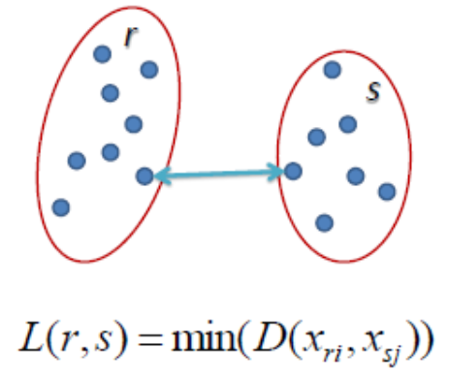
kinship matrix
kinship.cluster – average(default), complete, single, ward.D, mcquitty, median, and centroid
<average>
<complete>
<single>

Slide 20
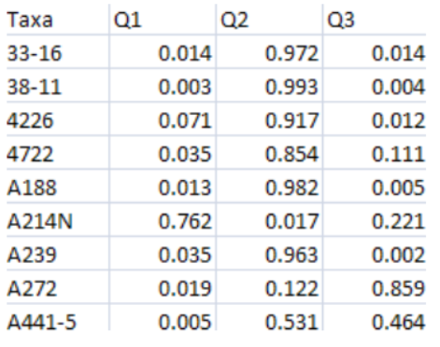
INPUT
• Covariate variables
A file containing covariates (called “CV” in GAPIT) can include information such as population structure, which are fitted into the GWAS and GS models as fixed effects.

Slide 21
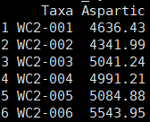
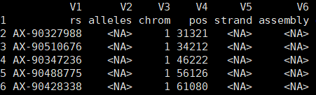
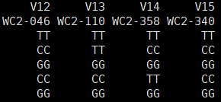
DATA
2
450
…
439
169029
…
…
raw_myY
raw_myX
439 samples, 169028 SNPs, 11 columns in X data are SNP information which is essential to use GAPIT.

Slide 22
PRACTICE_read data
library(multtest); library(gplots); library(LDheatmap); library(genetics)
library(ape); library(EMMREML); library(compiler)
library(scatterplot3d)
source("http://zzlab.net/GAPIT/gapit_functions.txt")
source("http://zzlab.net/GAPIT/emma.txt")
setwd("C:/Users/pc/Desktop/gapitex")
source("function.R")
library(data.table)
raw_myY <- read.table(file=“filename.csv", sep=",", header=T)[,1:2]
raw_myX <- as.data.frame(fread(file="filename.csv", sep=",", header=F))
head(raw_myY); raw_myX[1:5,1:20]
raw_myY <- raw_myY[,1:2]
dim(raw_myY); dim(raw_myX)

Slide 23
PRACTICE_pre-process data
#remove NA Y
Yna <- is.na(raw_myY[,2])
myY <- raw_myY[!Yna,]
myX <- raw_myX[,c(rep(T,11),!Yna)]
dim(myY);dim(myX)
# check proprotion of NA
genedata <- myX[-1,-c(1:11)]
na <- apply(genedata, 1, function(x) sum(x=='NN'))
length(na)
max(na); max(na)/nrow(genedata) # maximum NA percent: about 0.1%

Slide 24
PRACTICE_pre-process data
# check one genotype per SNP
one <- apply(genedata, 1, function(x) length(unique(x[x!="NN"]))==1)
sum(one)
wone <- which(one) + 1
myX <- myX[-wone,]
dim(myX) #161798 381
…

Slide 25
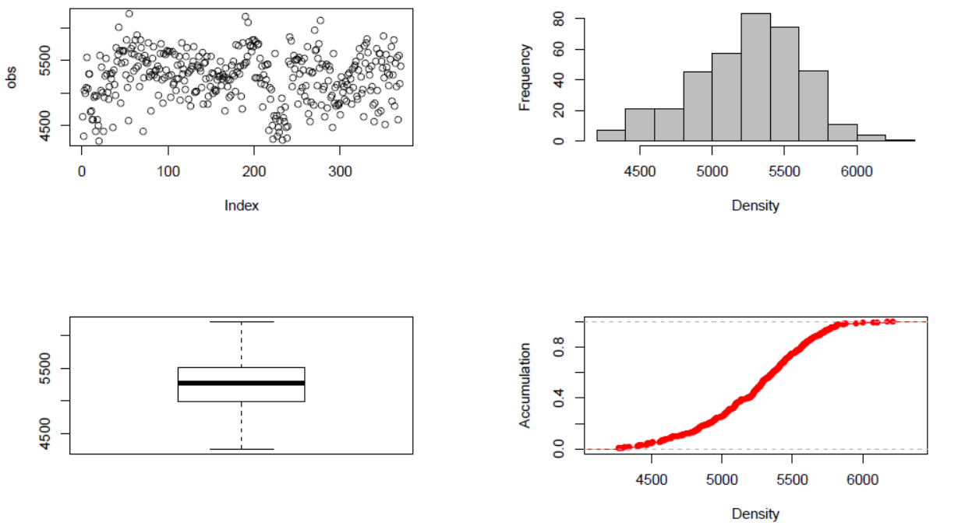
PRACTICE_ code 1: treating heterozygosity
setwd("C:/Users/pc/Desktop/gapitex/result1")
result1 <- GAPIT(Y=myY, G=myX)
summary(myY)
① Phenotype diagnosis
scatter plot
histogram
boxplot
accumulative distribution

Slide 26
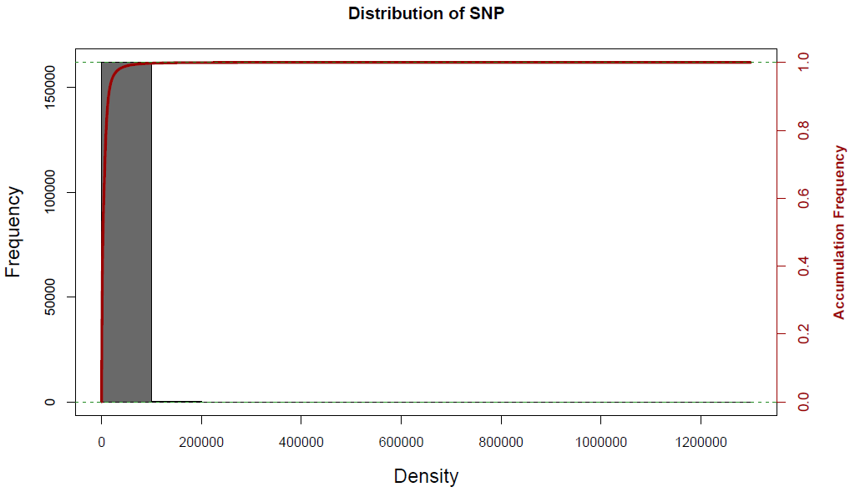
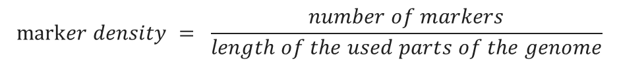
RESULT
② Marker density
Previous studies suggested selecting SNPs with large effects can produce almost as effective evaluation for GEBVs as HD panels.
$$marker density = \frac{number of markers}{length of the used parts of the genome}$$

Slide 27
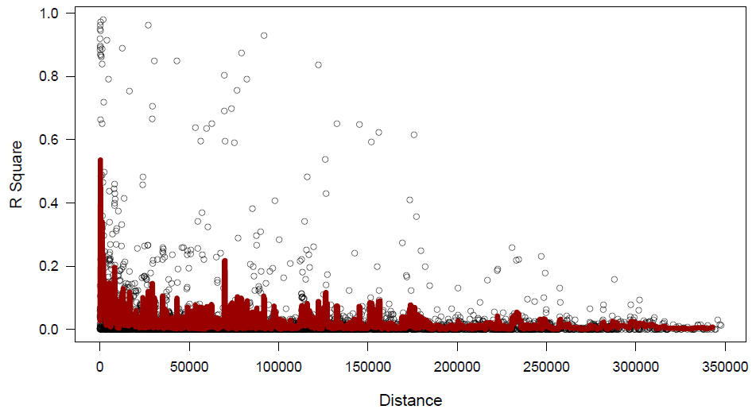
RESULT
③ Linkage Disequilibrium Decade
LD is important in GWAS because it allows us to get good coverage of the entire genome by genotyping only a small fraction of markers.
Each dot : a pair of distances between two markers on and their squared correlation coefficient
red line : moving average of the 10 adjacent markers.
“PLINK”

Slide 28
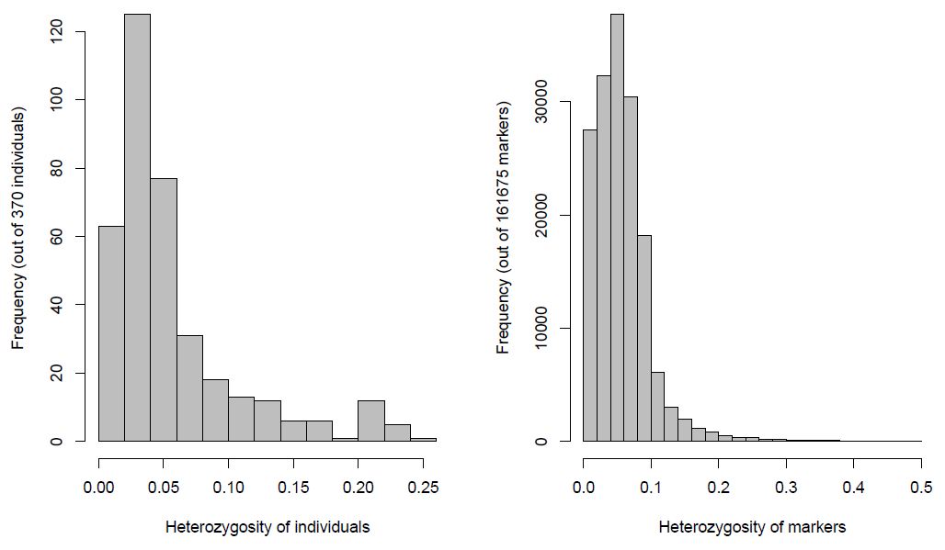
RESULT
④ Heterozygosis
High level of heterozygosis indicated low quality. For example, over 50% of heterozygosis on inbred lines for some of markers suggested they problematic.

Slide 29
PRACTICE_heterozygosity
myGD= apply(myX[-1,-(1:11)], 1,
function(one) GAPIT.Numericalization(one, bit=2, impute="Middle", Major.allele.zero=F))
H=1-abs(myGD-1)
het.ind=apply(H,1,mean)
het.snp=apply(H,2,mean)
hist(het.ind,col="gray", main="", xlab="Heterozygosity of individuals")
hist(het.snp,col="gray", main="", xlab="Heterozygosity of markers")
sum(het.ind > 0.5)
sum(het.snp > 0.5)
w1 <- which(het.snp > 0.5) + 1
myX <- myX[-w1,]
dim(myX) #161677 381
genotyping byte 1 or 2
imputation method
T: 0 means Major.allele
F: 0 means Minor.allele

Slide 30
PRACTICE_PCoA(principal coordinates analysis)
Principal Coordinates Analysis (PCoA, = Multidimensional scaling, MDS) is a method to explore and to visualize similarities or dissimilarities of data. It starts with a similarity matrix or dissimilarity matrix (= distance matrix) and assigns for each item a location in a low-dimensional space.
By using PCoA we can visualize individual and/or group differences. Individual differences can be used to show outliers.
library(ggplot2)
dim(myGD)
distance.matrix <- dist(myGD)
mds.stuff <- cmdscale(distance.matrix, eig=T, x.ret=T)
mds.var.per <- round(mds.stuff$eig/sum(mds.stuff$eig)*100,1)
mds.var.per[1:5]
mds.values <- mds.stuff$points
mds.data <- data.frame(Sample=1:nrow(myY), X=mds.values[,1], Y=mds.values[,2])

Slide 31
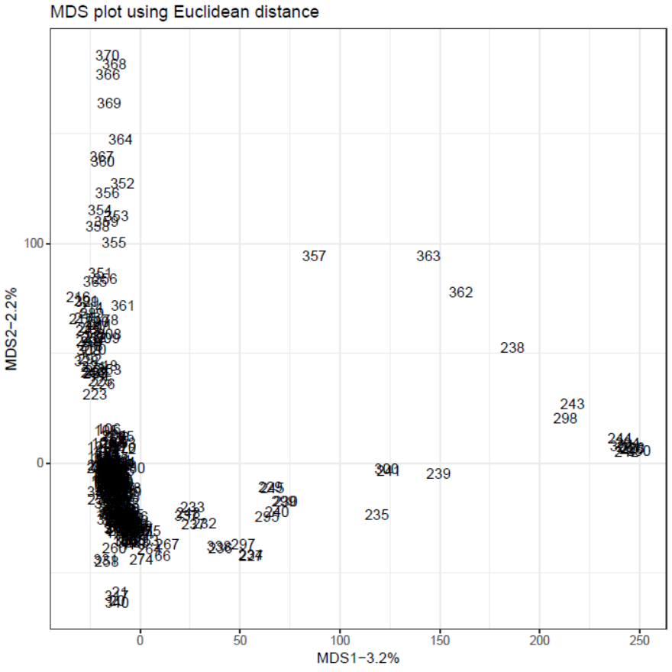
PRACTICE_PCoA(principal coordinates analysis)
pdf("PCoA.pdf")
gg <- ggplot(data=mds.data, aes(x=X, y=Y, label=Sample)) +
geom_text() +
theme_bw() +
xlab(paste("MDS1-", mds.var.per[1],"%", sep="")) +
ylab(paste("MDS2-", mds.var.per[2],"%", sep="")) +
ggtitle("MDS plot using Euclidean distance")
print(gg)
dev.off()

Slide 32
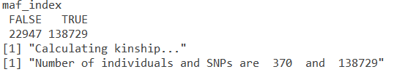
PRACTICE_code 2: imputation and controlling MAF
1. SNP imputation: use “SNP.impute” option
‘Major’: Major allele
‘Middle’: heterozygote(default)
’Minor’: Minor allele
2. Minor Allele Frequency(MAF) : use “SNP.MAF” option
MAF to filter SNPs in GWAS Reports, >0 and <1
setwd("C:/Users/pc/Desktop/gapitex/result2")
result2 <- GAPIT(Y=myY, G=myX, SNP.impute="Middle", SNP.MAF=0.02)

Slide 33
PRACTICE_code 3 : optimal PC number
setwd("C:/Users/pc/Desktop/gapitex/result3")
result3 <- GAPIT(Y=myY, G=myX, SNP.MAF=0.02, PCA.total=100, Model.selection=TRUE)
# optimal number of PC using BIC
BICdata <- read.csv("C:/Users/pc/Desktop/gapitex/result3/GAPIT.MLM.Aspartic.BIC.Model.Selection.Results.csv",
header=T)
head(BICdata)
BIC <- BICdata[,2]
BICdata[which.max(BIC),1]

Slide 34
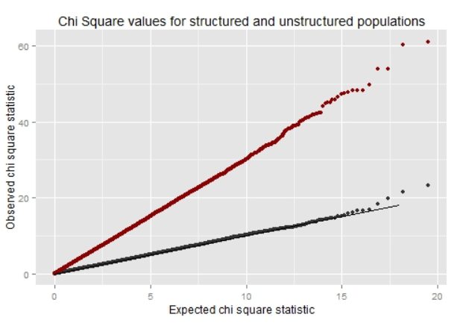
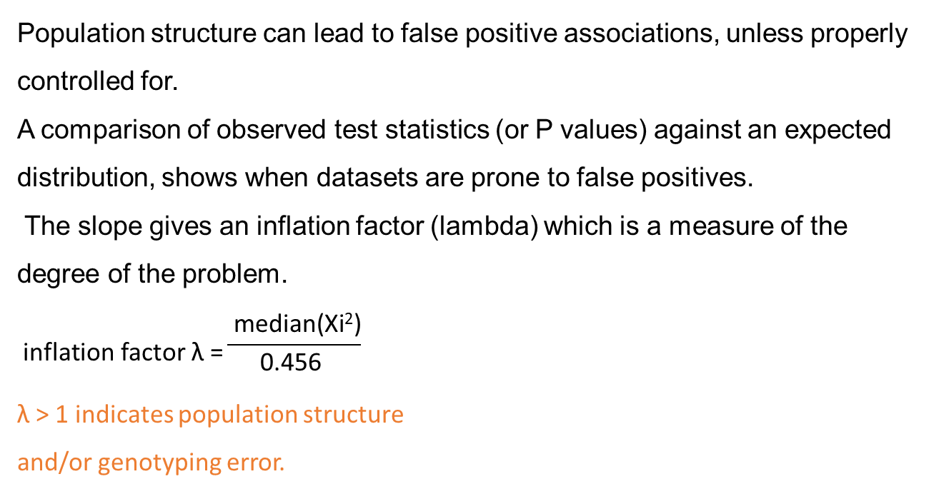
genomic inflation factor, lambda
Population structure can lead to false positive associations, unless properly controlled for.
A comparison of observed test statistics (or P values) against an expected distribution, shows when datasets are prone to false positives.
The slope gives an inflation factor (lambda) which is a measure of the degree of the problem.
$$\text{inflation} \text{factor} \text{λ}\text{ =}\frac{ \text{median}\text{(}\text{Xi}\text{2}\text{)}}{\text{0.456 }}$$
λ > 1 indicates population structure
and/or genotyping error.

Slide 35
PRACTICE_population structure using genomic inflation factor
pvaldata <-
read.csv("C:/Users/pc/Desktop/gapitex/result3/GAPIT.MLM.Aspartic.GWAS.Results.csv", header=T)
p <- pvaldata[,4]
if (stat_type == "Z") z = Z[, 1]
if (stat_type == "CHISQ") z = sqrt(CHI[, 1])
if (stat_type == "PVAL") z = qnorm(p / 2)
lambda = round(median(z^2) / 0.454, 3)
lambda

Slide 36
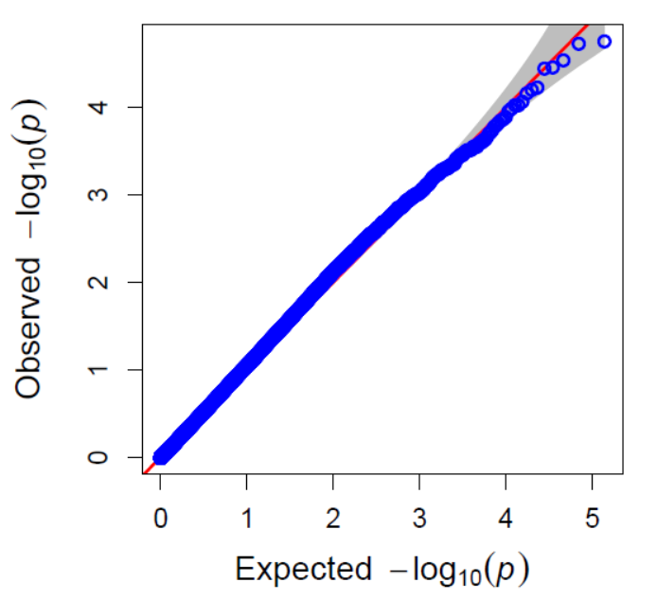
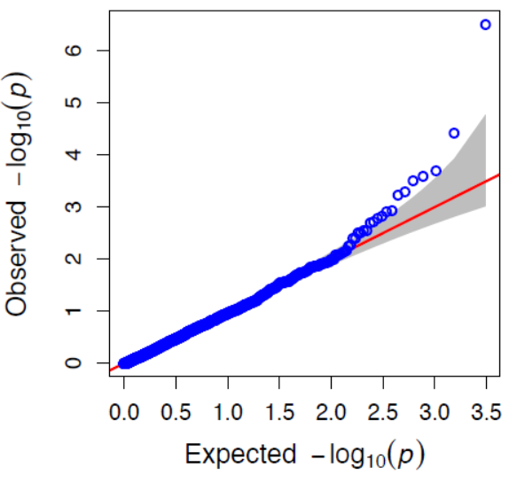
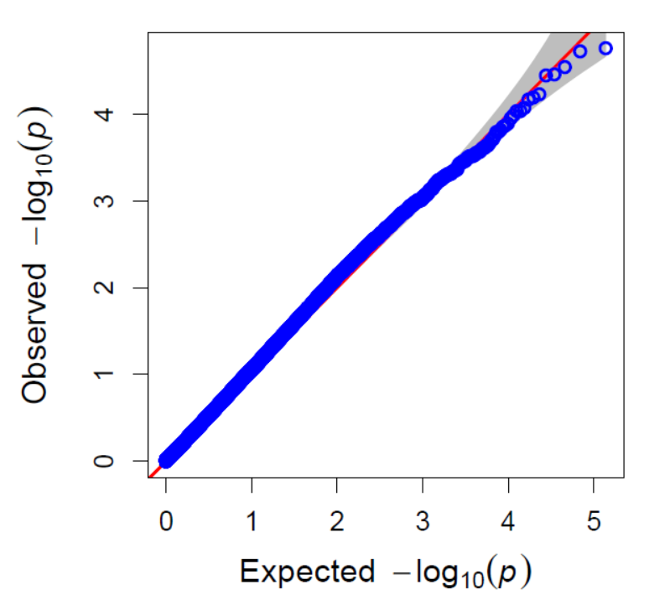
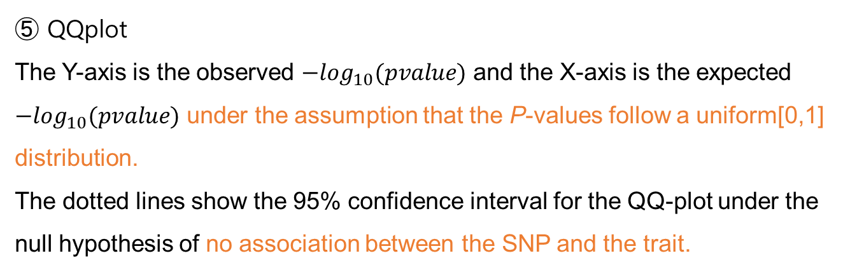
RESULT
⑤ QQplot
The Y-axis is the observed ${−log}_{10}(pvalue)$ and the X-axis is the expected ${−log}_{10}(pvalue)$ under the assumption that the P-values follow a uniform[0,1] distribution.
The dotted lines show the 95% confidence interval for the QQ-plot under the null hypothesis of no association between the SNP and the trait.
no association
with association
our result

Slide 37
PRACTICE_code4 : Compressed MLM
group.from(start group number), group.to(final group number), group.by(gap of group)
setwd("C:/Users/pc/Desktop/gapitex/result4")
result4 <- GAPIT(Y=myY, G=myX,
SNP.MAF=0.02,
group.to=370,
group.from=1,
group.by=1,
model="CMLM"
)

Slide 38
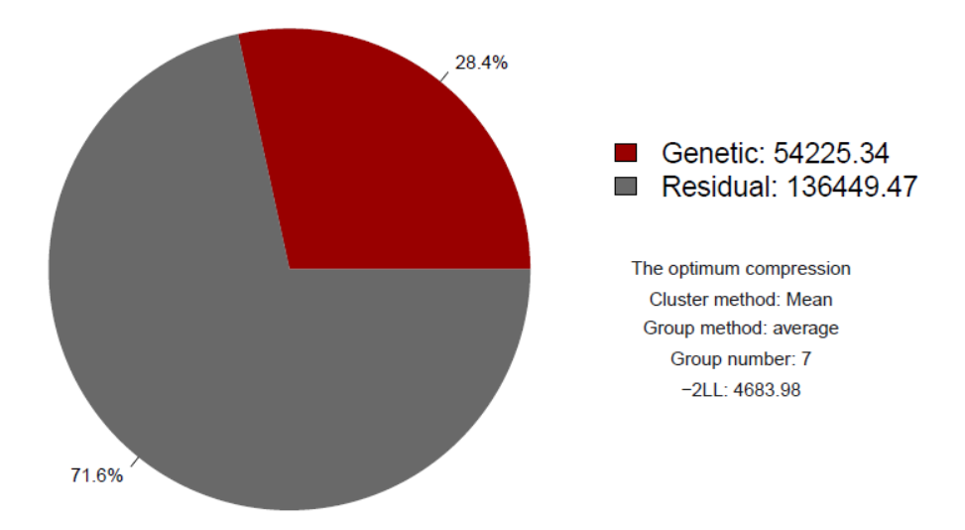
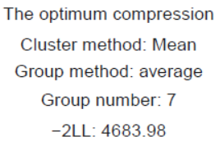
RESULT
⑥ Optimum Compression
GAPIT select optimal group number which maximize Log Likelihood.

Slide 39
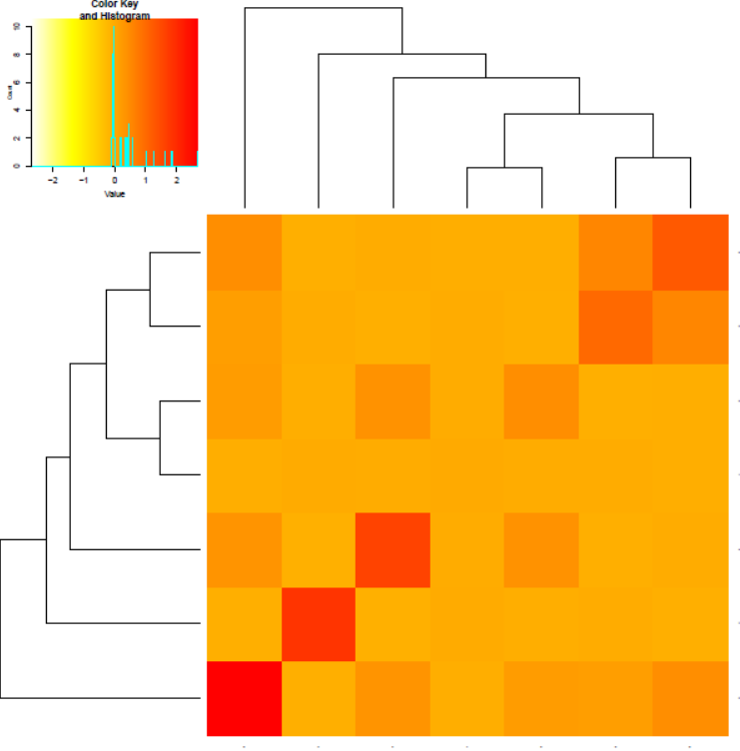
RESULT
⑦ Kinship plot
A heat map of the values in the values in the kinship matrix is created.

Slide 40
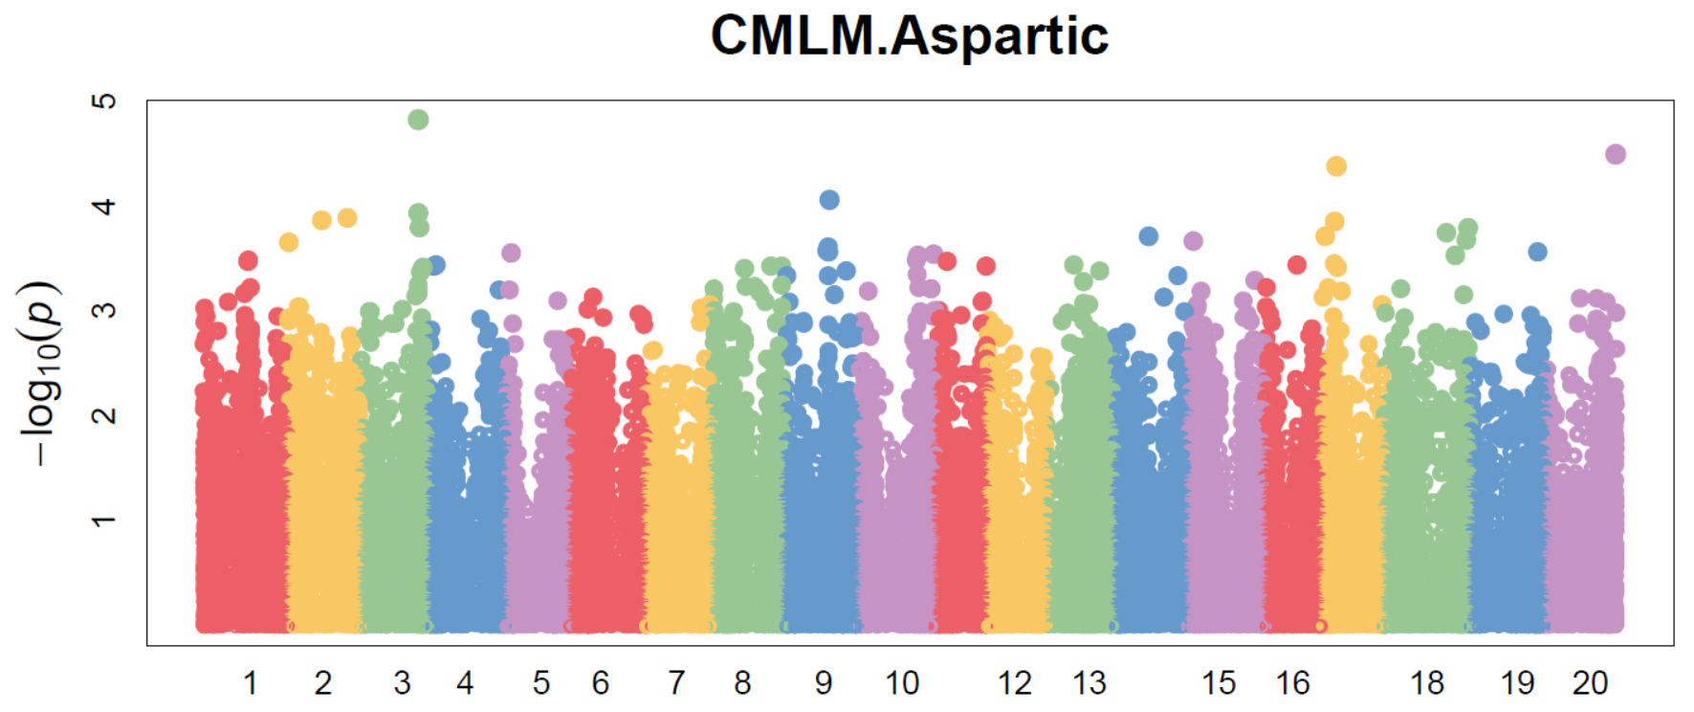
RESULT
⑧ Manhattan plot
- The Manhattan plot is a scatter plot that summarizes GWAS results.
- The X-axis is the genomic position of each SNP, and the Y-axis is the negative logarithm of the P-value obtained from the GWAS model.
- F-test for testing H0: No association between the SNP and trait.
- GAPIT’s default cutoff value is 0.05

Slide 41
PRACTICE_ code5 : Enriched CMLM
kinship.cluster: average(default), complete, single, ward.D, mcquitty, median,
and centroid
kinship.group: Mean, Max, Min, Median (Method to derive kinship among groups)
Optimal setting is considered to be maximizing LL(log likelihood).
setwd("C:/Users/pc/Desktop/gapitex/result5")
result5 <- GAPIT(Y=myY, G=myX,
SNP.MAF=0.02,
kinship.cluster=c("average", "complete", "ward.D"),
kinship.group=c("Mean", "Max"),
group.from=1,
group.to=370,
group.by=1,
memo="ECMLM"
)
In our case, number of Setting:
3("average", "complete", "ward.D") * 2("Mean", "Max") *
370(possible group number)
= 2220

Slide 42
PRACTICE_small p-value
# small p-value
pvaldata <- read.csv("C:/Users/pc/Desktop/gapitex/result5/GAPIT.CMLM.Aspartic.GWAS.Results.csv", header=T)
head(pvaldata)
o <- order(pvaldata$P.value)
opvaldata <- pvaldata[o,]
head(opvaldata)

Slide 43
Part 2. Regularization

Slide 44
Data description
Traits (Y) - Total sum of 17 essential amino acids
Genomic data (X) - 370 samples and 15,000 variants were extracted from the SNP data with 439 samples and 157,762 variants for convenience.
Continuous variable

Slide 45
Goals of genome-wide association studies
(Variable selection) - Identify the genetic variants or genomic region associated with a trait or a disease to better understand the biology of disease.
(Prediction) - Make prediction susceptibilities for disease and who is at risk for prevention or better treatment

Slide 46
Variable selection in high-dimensional data
“Small n, large p” problem → Subset selection with “least squares” cannot be used, because the covariance matrix is not invertible.
The answer is regularization using a penalty function → A penalty can shrink coefficients which are less associated with response ※ Goals of regularization - Variable selection - Interpretation

Slide 47
The tradeoff between interpretability and flexibility
High interpretability &
Low flexibility (prediction)
James, G., et al. (2013) “An Introduction to Statistical Learning with applications in R”

Slide 48
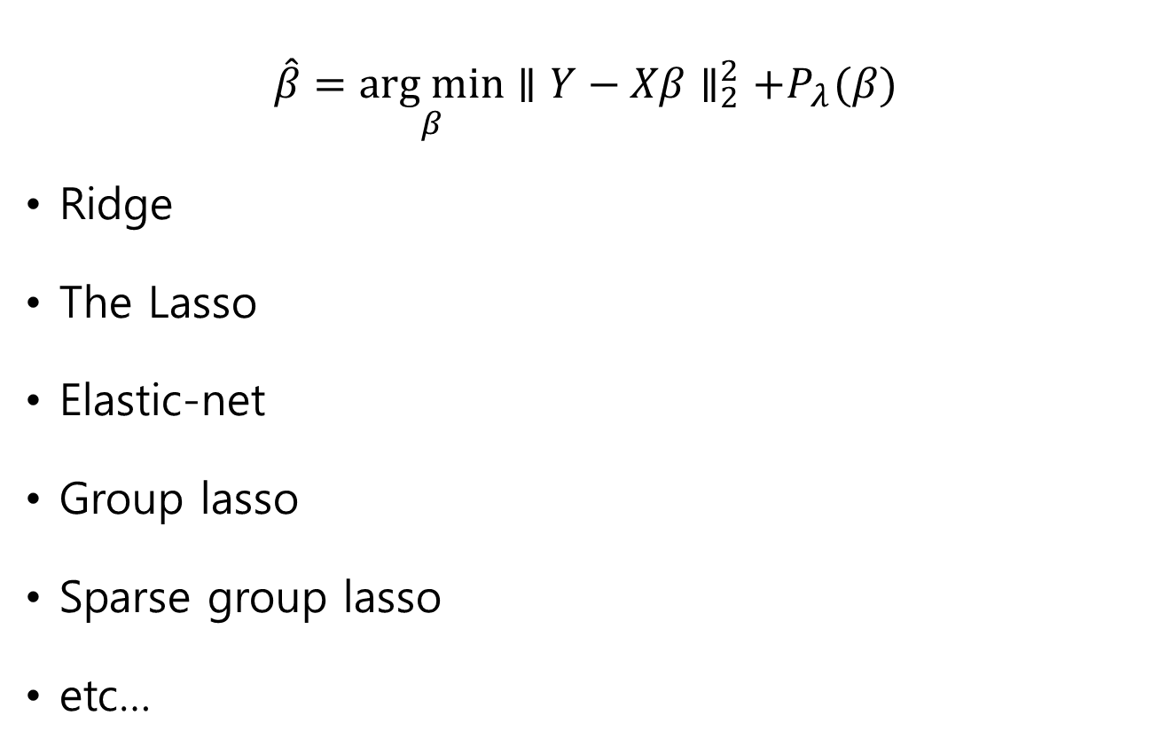
Regularization procedures
$$\hat{β}=\underset{β}{arg min}{∥Y−Xβ∥_{2}^{2}+P_{λ}(β)}$$
Ridge
The Lasso
Elastic-net
Group lasso
Sparse group lasso
etc…
Least squares
Penalty function

Slide 49
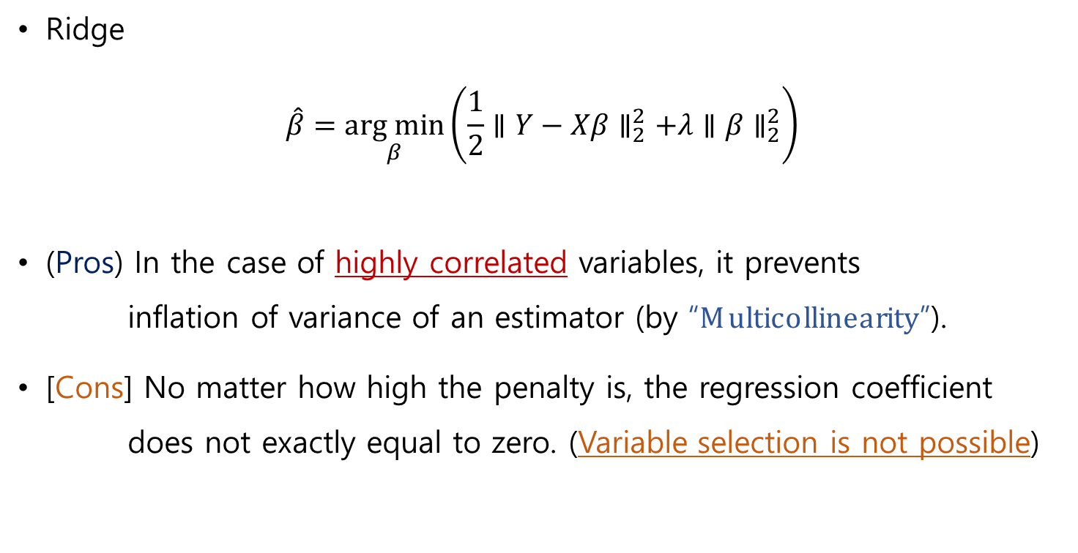
Ridge
Ridge
$$\hat{β}=\underset{β}{arg min}\left(\frac{1}{2}∥Y−Xβ∥_{2}^{2}+λ∥β∥_{2}^{2}\right)$$
(Pros) In the case of highly correlated variables, it prevents inflation of variance of an estimator (by “Multicollinearity”).
[Cons] No matter how high the penalty is, the regression coefficient does not exactly equal to zero. (Variable selection is not possible)

Slide 50
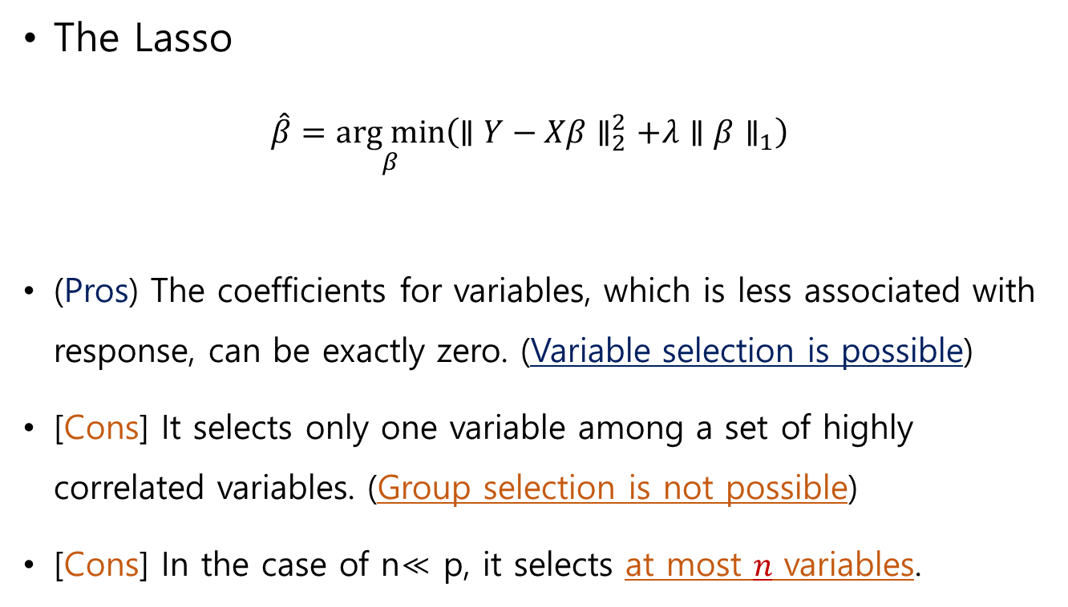
The Lasso
The Lasso
$$\hat{β}=\underset{β}{arg min}\left(∥Y−Xβ∥_{2}^{2}+λ∥β∥_{1}\right)$$
(Pros) The coefficients for variables, which is less associated with response, can be exactly zero. (Variable selection is possible)
[Cons] It selects only one variable among a set of highly correlated variables. (Group selection is not possible)
[Cons] In the case of n≪ p, it selects at most $n$ variables.

Slide 51
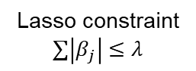
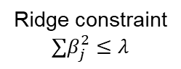
A difference between lasso and ridge
Least square estimates
Lasso estimates
Ridge estimates
Lasso constraint
$$∑\left|β_{j}\right|≤λ$$
Ridge constraint
$$∑β_{j}^{2}≤λ$$
James, G., et al. (2013) “An Introduction to Statistical Learning with applications in R”

Slide 52
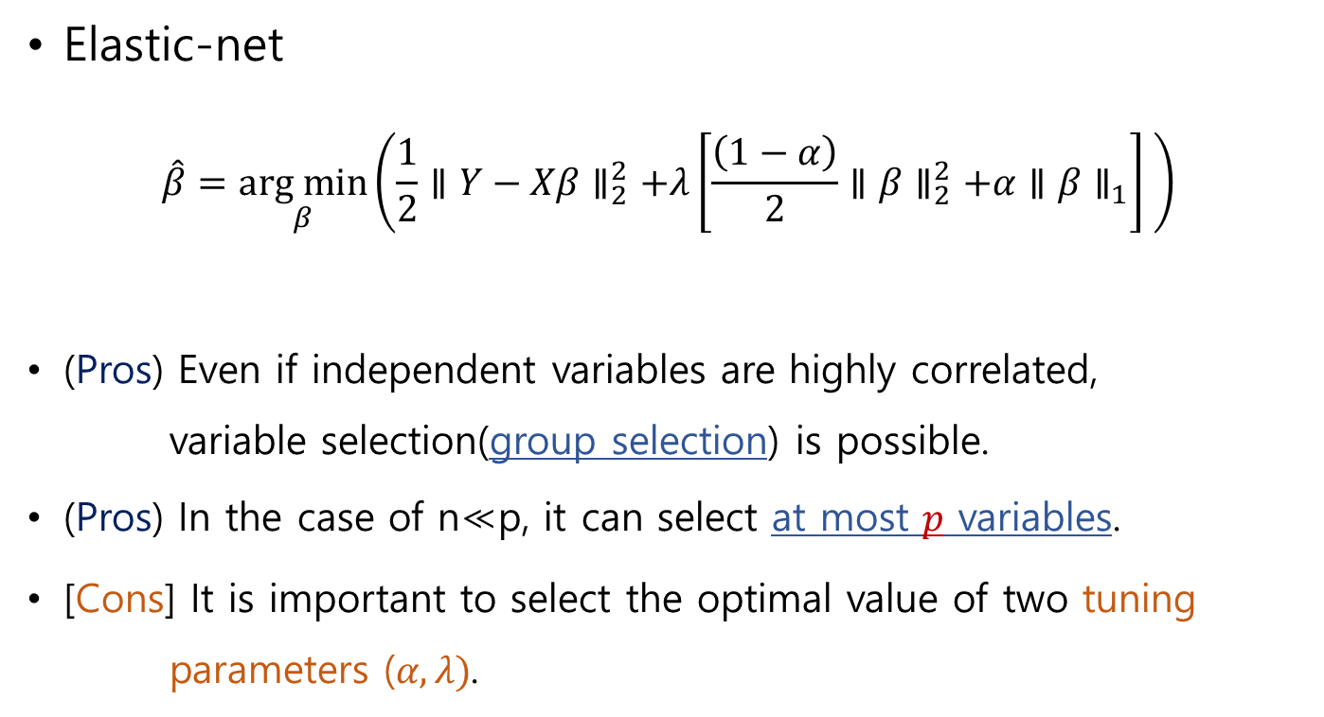
Elastic-net
Elastic-net
$$\hat{β}=\underset{β}{arg min}\left(\frac{1}{2}∥Y−Xβ∥_{2}^{2}+λ\left[\frac{\left(1−α\right)}{2}∥β∥_{2}^{2}+α∥β∥_{1}\right] \right)$$
(Pros) Even if independent variables are highly correlated, variable selection(group selection) is possible.
(Pros) In the case of n≪p, it can select at most $p$ variables.
[Cons] It is important to select the optimal value of two tuning parameters ($α, λ)$.

Slide 53
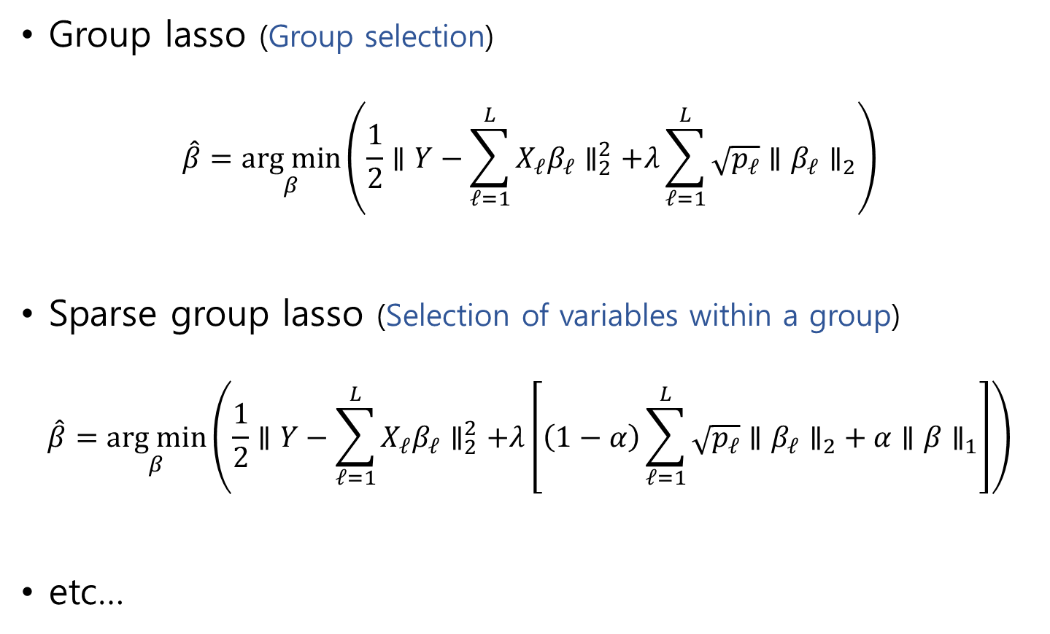
Others
Group lasso (Group selection)
$$\hat{β}=\underset{β}{arg min}\left(\frac{1}{2}∥Y−\sum_{ℓ=1}^{L}{X_{ℓ}β_{ℓ}}∥_{2}^{2}+λ\sum_{ℓ=1}^{L}{\sqrt{p_{ℓ}}∥β_{ℓ}∥_{2}}\right)$$
Sparse group lasso (Selection of variables within a group)
$$\hat{β}=\underset{β}{arg min}\left(\frac{1}{2}∥Y−\sum_{ℓ=1}^{L}{X_{ℓ}β_{ℓ}}∥_{2}^{2}+λ\left[\left(1−α\right)\sum_{ℓ=1}^{L}{\sqrt{p_{ℓ}}∥β_{ℓ}∥_{2}}+α∥β∥_{1}\right]\right)$$
etc…

Slide 54
“glmnet”
Generalized linear model (GLM) regularized with lasso and elastic-NET
GLMs are commonly used to model various types of response variable, for instance, continuous, binary, count, survival time, and etc.
In “glmnet”, there are also many types of regression, such as linear, logistic, poisson, and cox regression.

Slide 55
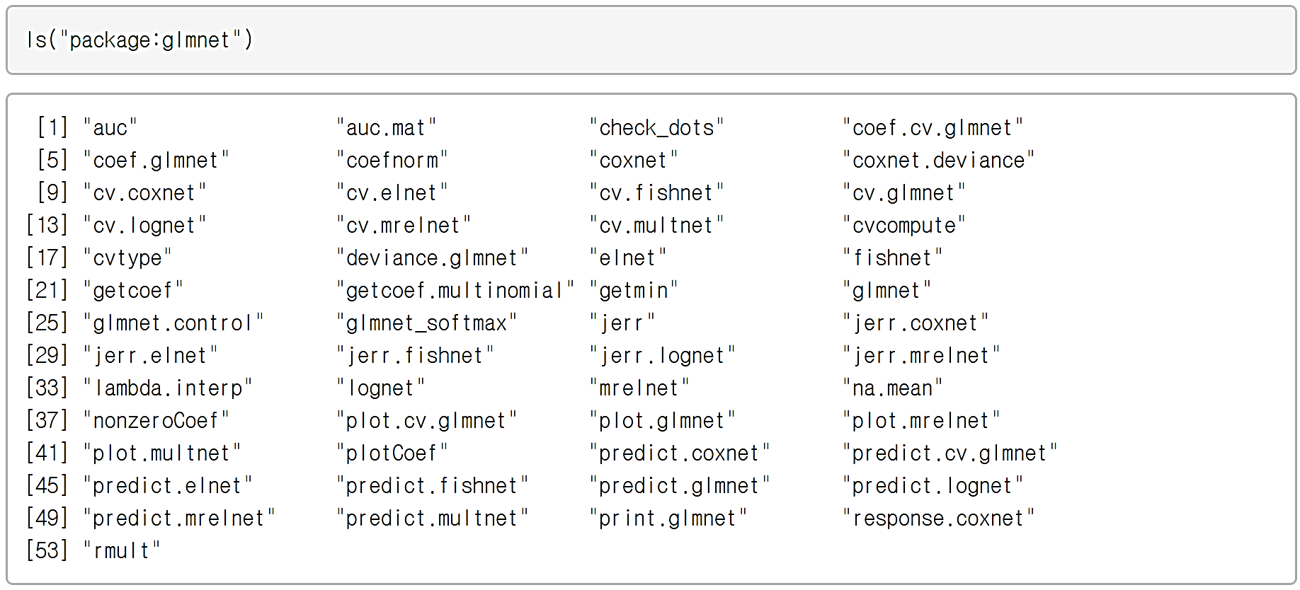
Elements of “glmnet”

Slide 56
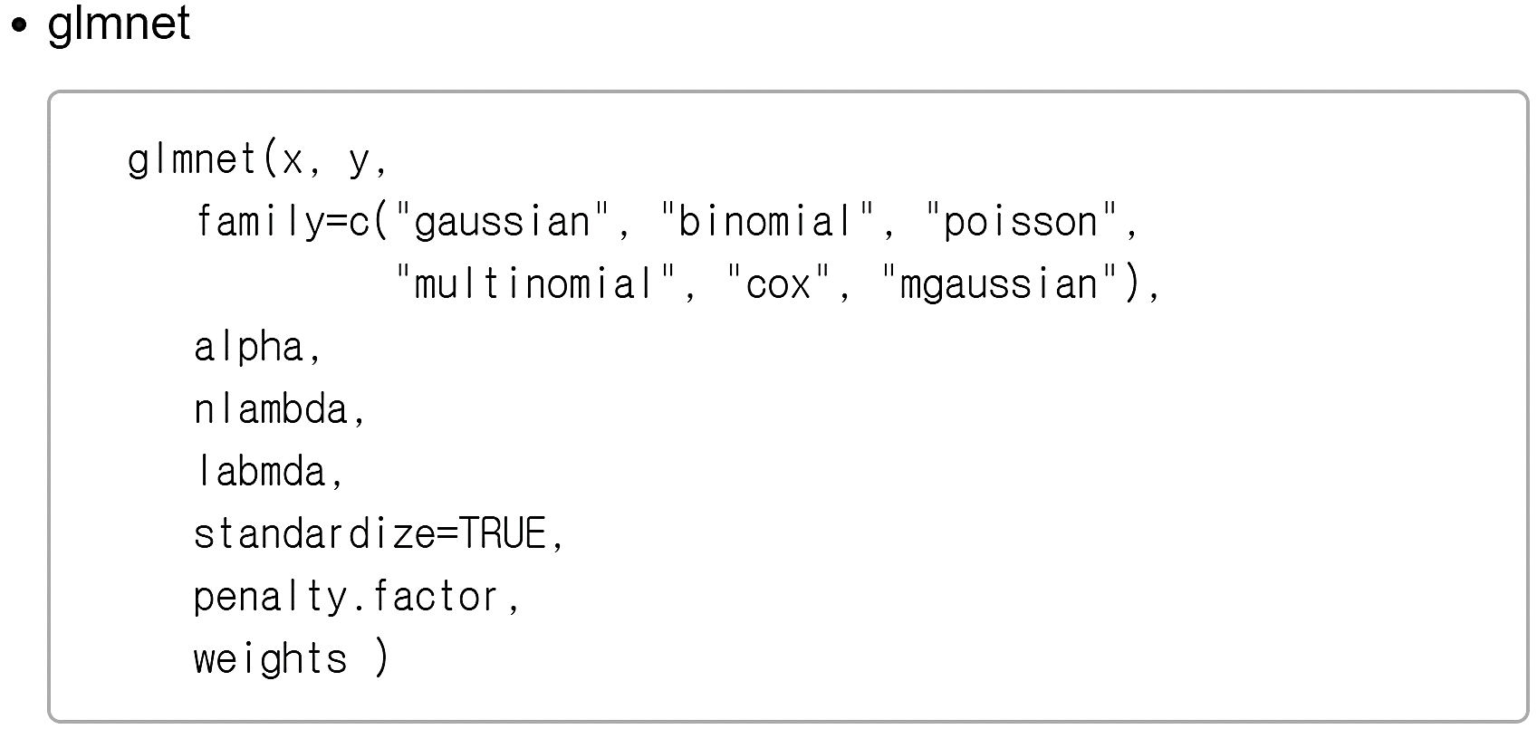
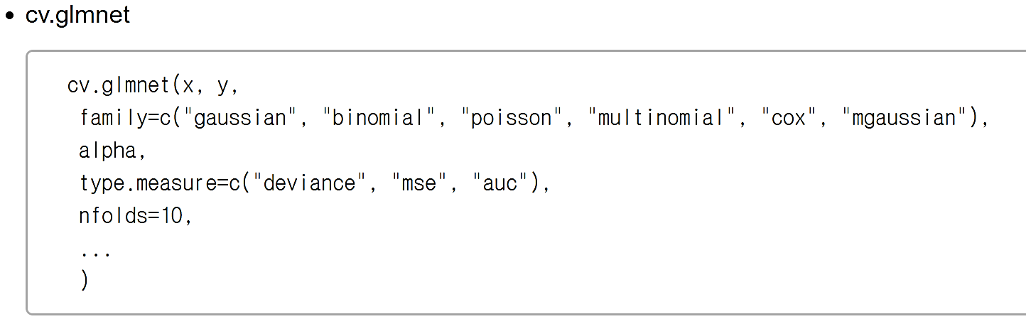
Main functions of “glmnet”

Slide 57
The Lasso

Slide 58
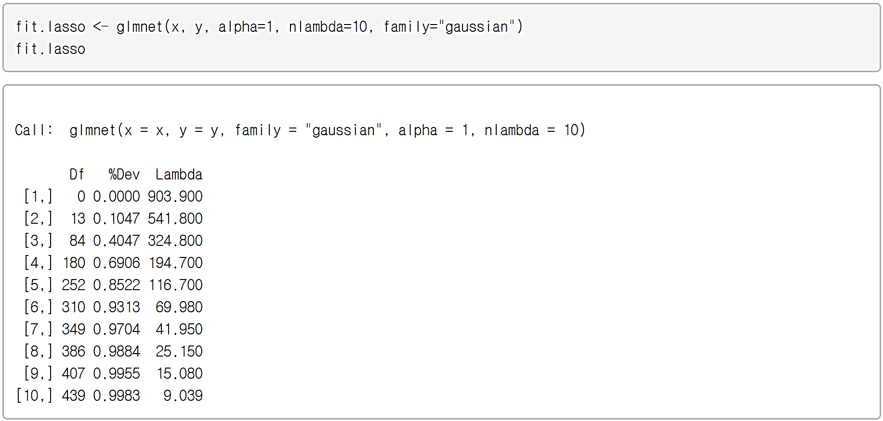
The Lasso
the number of lambda value which will be fitted,
recommended to be 100 or more.
α=0 (ridge), α=1 (lasso), and 0<α<1 (elastic-net)
Lambda : the lambda value determining the strength of penalty
Df : # of the nonzero coefficients
%Dev : the percentage of deviance explained (for gaussian, R-square)
This is not an absolute criterion, because %Dev increases as variables are added.

Slide 59
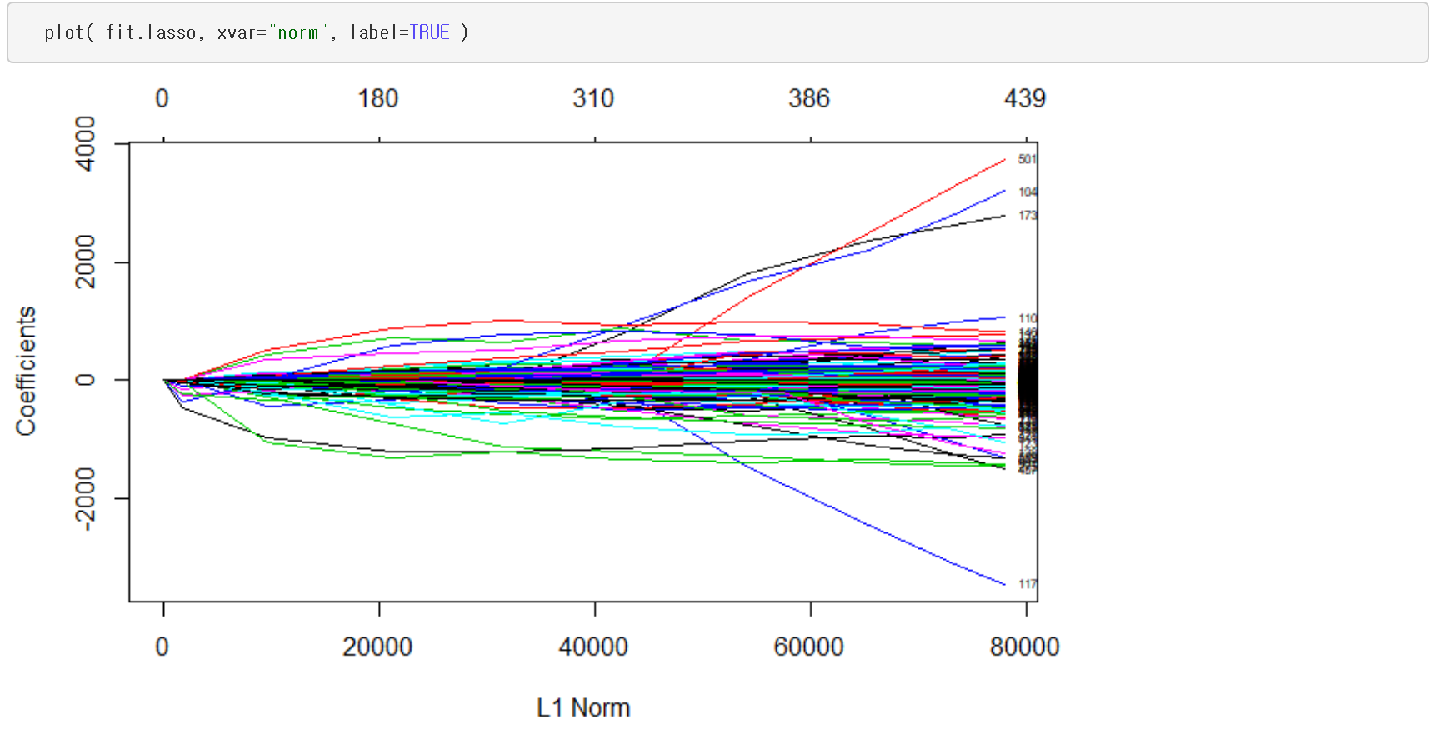
Solution path for lasso
If TRUE, labels the curves with variable numbers.
Measurement on the X-axis includes “norm”, “lambda”, and “dev”.
The number of nonzero coefficients
Sum of absolute value of regression coefficients

Slide 60
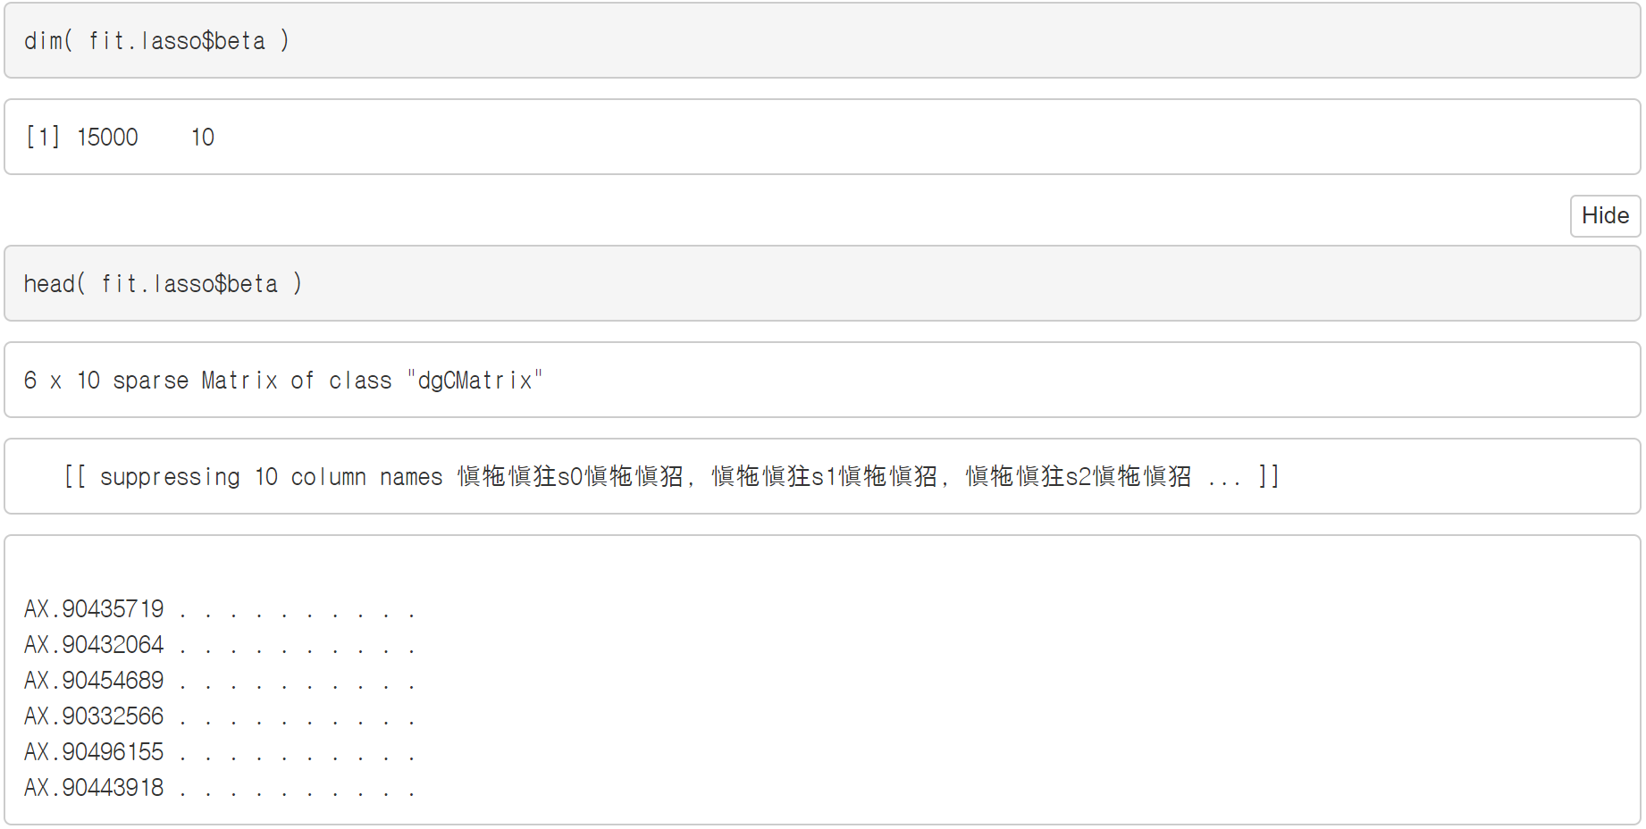
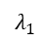
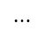
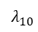
How to get coefficients
$$λ_{1}$$
$$⋯$$
$$λ_{10}$$
Sparse matrix to reduce memory usage

Slide 61
Others to retrieve coefficients for a specific λ
For the 5th lambda, - “coef” - “predict”
Set a specific λ value
To get coefficients
Set a specific λ value

Slide 62
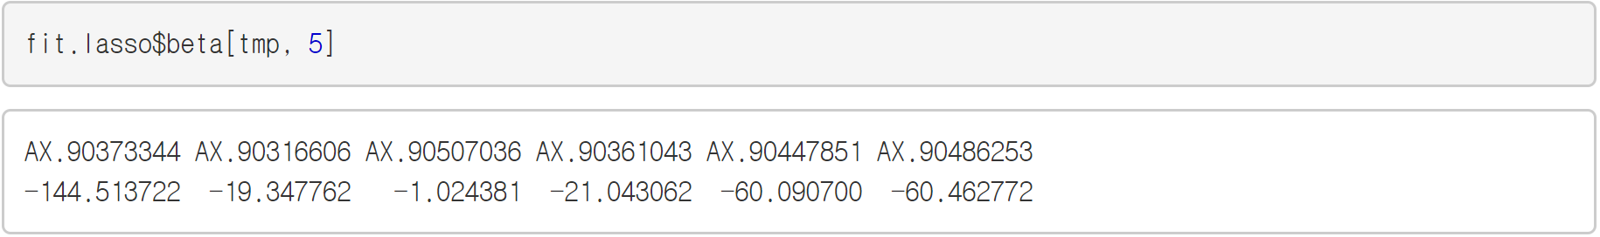


The results of three functions are same
For the 5th λ value
“coef” and “predict” have an intercept (${\hat{β}}_{0})$

Slide 63

Coefficients in solution path
The 5th λ value of “fit.lasso” = 116.7
log116.7

Slide 64
Which is better, more and fewer?
As shown above, the coefficients depend on lambda.
Which is the best, having more variables or fewer variables?
(Example) n=50, p=30; true coefficients: 10 large, 20 small <Goal> Lambda value which has the smallest MSE (black curve)
More
Fewer
James, G., et al. (2013) “An Introduction to Statistical Learning with applications in R”

Slide 65

Model selection
How to choose the optimal lambda value?
Model selection - (Goal) To select a model which has the best model criterion. - λ sequence : $λ_{1}$, $λ_{2}$, $⋯$, $λ_{100}$ - Model criteria : (1) Mean squared error (2) Deviance (3) Misclassification error (4) AUC (Area Under the Curve)
fit.lasso
Binary response

Slide 66

Overfitting
Overfitting : construct a complicated model which do not explain new datasets.

Slide 67
Cross-validation to prevent overfitting
How to avoid the overfitting problem? - The answer is K-fold Cross-validation
Cross-validation is to apply model selection for training set and test set to avoid overfitting

Slide 68

Cross-validation
Example) 5-fold cross-validation
Model criteria 1
Model criteria 2
Averaged model criteria
Model criteria 3
Model criteria 4
Model criteria 5

Slide 69




Procedure of selecting tuning parameter
λ sequence : $λ_{1}$, $λ_{2}$, $⋯$, $λ_{100}$
$$λ_{1}$$
‧ ‧ ‧
Select the optimal λ,
which has the smallest
the averaged model criteria
$$λ_{100}$$

Slide 70

Cross-validation in “glmnet”
cv.glmnet
Model criterion
cvm : averaged mse
cvsd : standard deviation of mse
cvup : cvm + cvsd
cvlo : cvm - cvsd
nzero : # of nozero coefficients
name : name of model criterion
The optimal lambda values

Slide 71

Cross-validation in “glmnet”
Cross-validation curve with error bars of SE
lambda.min: lambda value which has the smallest mean-squared error
lambda.1se: lambda value which gives the most regularized model such that error is within one standard error of minimum
lambda.1se
lambda.min

Slide 72




Optimal tuning parameter
Recommend !
Too few

Slide 73
Comparison with univariate analysis

Slide 74

Comparison I
Univariate analysis for each variable (example) Linear regression of the first variant on a trait

Slide 75



Comparison II
For-loop over all variables to get p-values of univariate analysis
Variables which have only one value

Slide 76

Comparison III
Struct a data.frame with a reference

Slide 77

Manhattan plot
Green dots: variables selected by lasso
Red line: genome-wide significant line [=-log10(5.0e-08)]
Blue line: Bonferroni significant line [=-log10(3.3e-06)]
R package “qqman”
Bonferroni’s corrected significance level = $α/p$

Slide 78
Prediction I
Splitting training and test set
Cross-validation
Fitting lasso with optimal lambda (min & 1se)

Slide 79


Prediction II
Results of the lasso with the optimal lambda values

Slide 80

Prediction III
Predicting a new dataset with the lasso-trained model.
※ Notification Since the lasso is not a prediction model, so the prediction results is not good

Slide 81
Elastic-net

Slide 82


Elastic-net for binary response
Transform “y” into binary data based on median value
In the case of binary response, family=“binomial” (logistic regression model)

Slide 83



Selecting the optimal tuning parameters
To compare the measurement for each alpha with the same dataset.

Slide 84


Additional grid search for alpha
The optimal alpha may be in [0, 0.01), but we do not investigate the alpha range, in which the models have too many variables.

Slide 85



Our final model selection
We select this as our final model.
Remember that
choosing lambda for the goal of reducing MSE, for the sake of variable selection, is somewhat of a different task.
Too many.

Slide 86


Comparison in manhattan plot
Green dots: variables selected by elastic-net
Red line: genome-wide significant line [=-log10(5.0e-08)]
Blue line: Bonferroni significant line [=-log10(3.3e-06)]

Slide 87
Covariate-adjusted model

Slide 88



Arbitrary covariates related with “y2”
Generating arbitrary covariates from probability distribution
probability of getting “1” = 0.8
Poisson distribution with mean of 40

Slide 89


Including covariates in “glmnet”
The variables with penalty.factor=0 are always included.
Set the first two elements of penalty.factor to 0
Two variables are always included.

Slide 90
What are benefits of covariate?
By adding the covariates in a model, we adjust the effects of the covariates on the phenotype of interest.
We can also adjust the effects of stratification such as race or species using the eigen vectors or the principal components
Therefore, we can only focus on the effects of genetic variants.

Slide 91
Part 3. Stability selection

Slide 92
Stability selection
Regularization procedures such as elastic-net outperform univariate analysis in terms of variable selection in many studies.
However, its results depend on how to select the optimal tuning parameters.
To address this issue, stability selection (Meinshausen and Buhlmann, 2010) was proposed.

Slide 93

Definition (Selection probabilities)
Algorithm Selection Probability with Elastic-net
0: | Let us assume that SNP data has $n$ samples and $p$ variables.
1: | For all $Λ=\left(α, λ\right)$, where $α∈\left[0,1\right], λ>0$
2: | for k=1 to K do
3: | Subsample $I_{k}$ with size $\left\lfloor \left.\text{n}\text{/2}\right\rfloor \right.$
4: | Compute ${\hat{β}}_{j}^{Λ}(I_{k})$ with regularization model
5: | end for
6: | $SP_{j}^{Λ}=\frac{1}{K}\#\{k≤K:{\hat{β}}_{j}^{Λ}\left(I_{k}\right)≠0\}$
7: | $SP_{j}=\max_{Λ}{SP_{j}^{Λ}}, j=1, ⋯, p$
8: | return $SP=\left(SP_{1}, ⋯, SP_{p}\right)$
A grid of
tuning parameters
Subsampling
(“subagging”)
Selection probabilities
Stability

Slide 94



Setting a grid of tuning parameters

Slide 95

























Applying regularization for the same subsamples
With the same subsamples,
applying regularization for all tuning parameters
Subsampling
$$λ_{1}$$
$$λ_{2}$$
$$⋯$$
$$λ_{100}$$
$${{\hat{β}}^{Λ}}_{j}\left(I_{k}\right)$$
$${Λ=(0.1, λ}_{1}) \\ j=1, ⋯,p$$
$${{\hat{β}}^{Λ}}_{j}\left(I_{k}\right)$$
$${Λ=(0.1, λ}_{2}) \\ j=1, ⋯,p$$
$${{\hat{β}}^{Λ}}_{j}\left(I_{k}\right)$$
$${Λ=(0.1, λ}_{10}) \\ j=1, ⋯,p$$
$$I_{1}$$
$$α=0.1$$
$$⋯$$
$${{\hat{β}}^{Λ}}_{j}\left(I_{k}\right)$$
$${Λ=(0.2, λ}_{1}) \\ j=1, ⋯,p$$
$${{\hat{β}}^{Λ}}_{j}\left(I_{k}\right)$$
$${Λ=(0.2, λ}_{2}) \\ j=1, ⋯,p$$
$${{\hat{β}}^{Λ}}_{j}\left(I_{k}\right)$$
$${Λ=(0.2, λ}_{10})$$
$$j=1, ⋯,p$$
$$⋮$$
$$α=0.2$$
$$⋮$$
$$⋮$$
$$⋱$$
$$⋮$$
$$I_{K}$$
$${{\hat{β}}^{Λ}}_{j}\left(I_{k}\right)$$
$${Λ=(0.9, λ}_{1})$$
$$j=1, ⋯,p$$
$${{\hat{β}}^{Λ}}_{j}\left(I_{k}\right)$$
$${Λ=(0.9, λ}_{2})$$
$$j=1, ⋯,p$$
$${{\hat{β}}^{Λ}}_{j}\left(I_{k}\right)$$
$${Λ=(0.9, λ}_{10})$$
$$j=1, ⋯,p$$
$$α=0.9$$
$$⋯$$

Slide 96


Calculating the selection probabilities
Subsampling
Applying regularization
Selection probabilities

Slide 97
Why split data with 0.5 proportion
The answer is sub-bootstrap aggregating (subagging)
Although the accuracy with 0.5 subsampling proportion is same as with whole samples, the computational time is much cheaper.
Buhlmann and Yu (2002). ANALYZING BAGGING. The anals of statistics. Vol 30(4): 927-961

Slide 98
Subagging
Subagging reduces the variance of estimator with the same accuracy as “bagging”
Buhlmann and Yu (2002). “ANALYZING BAGGING”. The anals of statistics, 30(4): 927-961

Slide 99


Summary of calculating sel.prob
Alpha grid
10 is enough
Lambda grid
Subsampling with size $\left\lfloor n/2\right\rfloor$
Applying regularization for each value of a grid
Selection probabilities

Slide 100

Threshold to control the false positive
Error control with threshold $π_{thr}$, $E\left(V\right)≤\frac{1}{2π_{thr}−1}\frac{q_{Λ}^{2}}{p},$ where E(V) is the expected number of falsely selected variables, $q_{Λ}$ is the averaged number of selected variables for the domain $Λ$.
From the above inequality, threshold can be defined as $π_{thr}=\frac{1}{E(V)}\frac{q_{Λ}^{2}}{2p}+\frac{1}{2}$

Slide 101




Calculation of the threshold ($π_{thr}$)
“sp” is an array of sel.prob with (variables, alpha, lambda)
Calculation of $q_{Λ}$
Calculation of $π_{thr}$

Slide 102




Manhattan plot with sel.prob ≥ $π_{thr}$
Green dots: variables whose “sel.prob” is greater than or equal to $π_{thr}$.
Threshold.5
Threshold.10

Slide 103



Stability selection <R code>
Since this section only shows the stability of selection probabilities, this is not necessary in real data analysis
Significant genes from theoretical.threshold10
Plotting

Slide 104

Stability selection <figure>
The stability path with elastic-net ($α=0.1$)

Slide 105
The end

